Slide 1
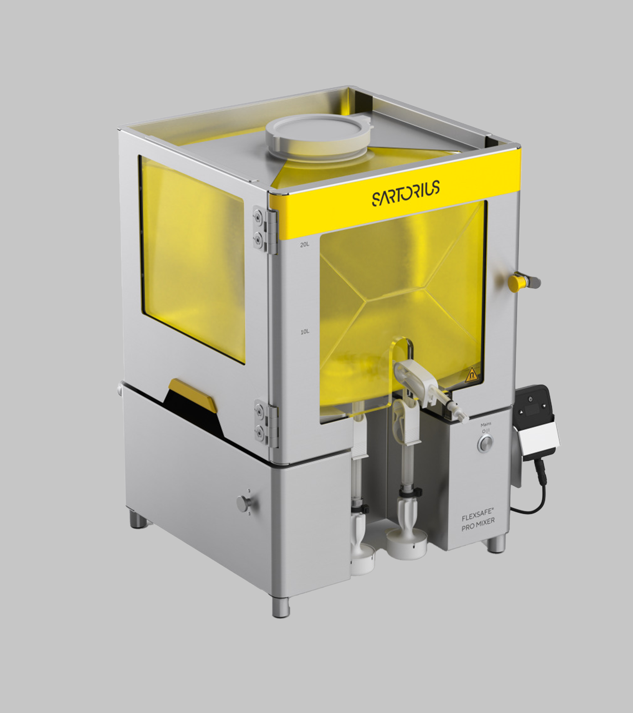
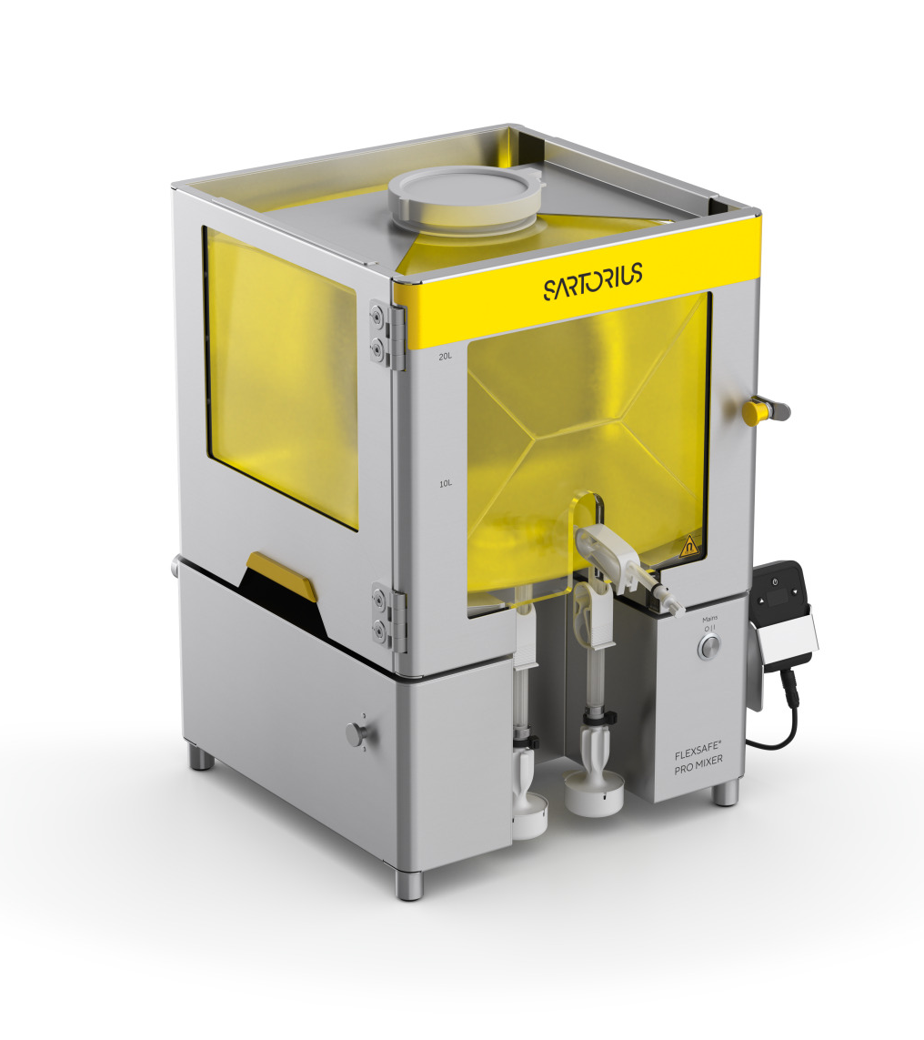
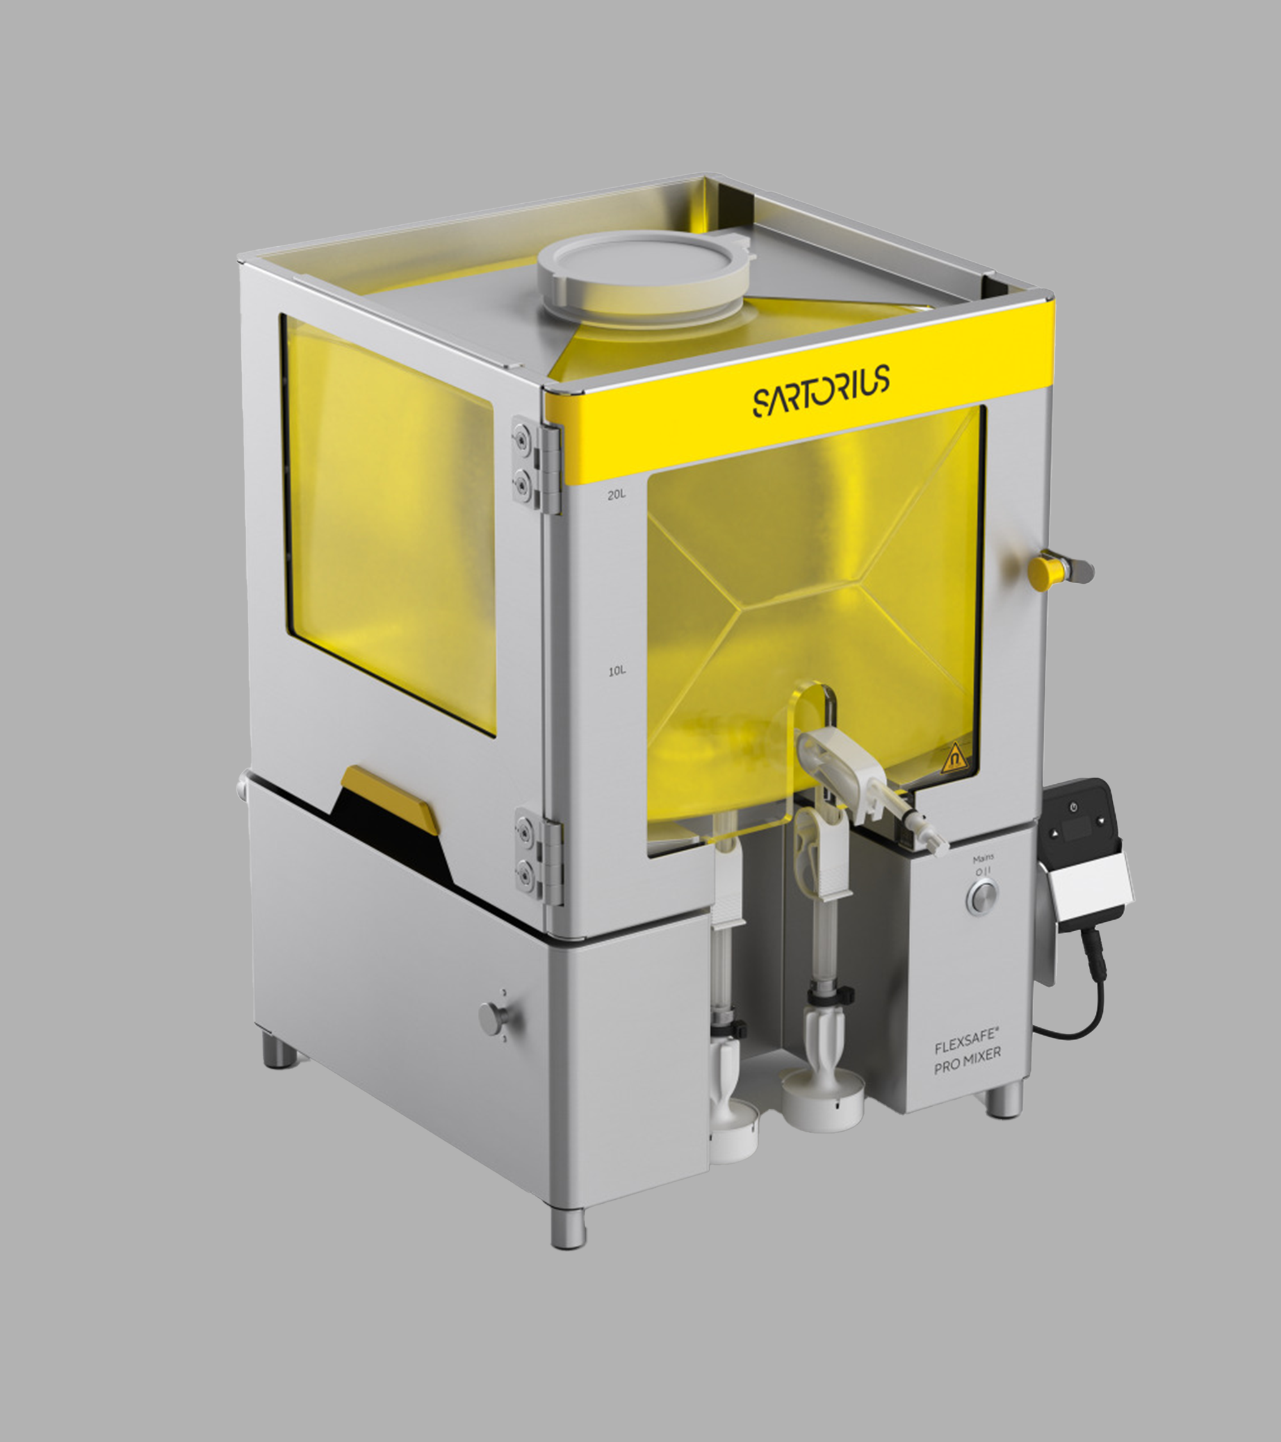

Flexsafe® Pro Mixer 5 L | 10 L | 20 L
Placeholder Image
September 2025

Slide 2
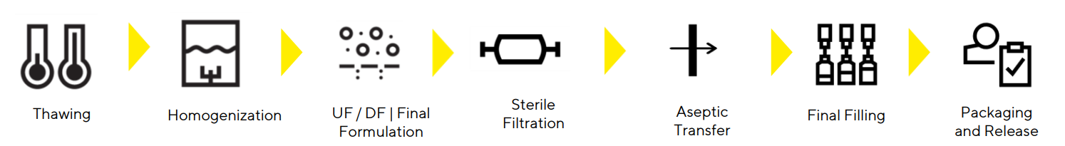
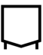
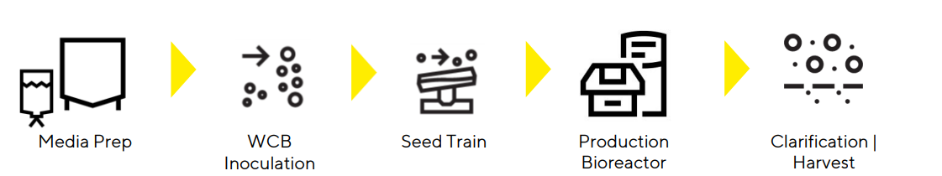
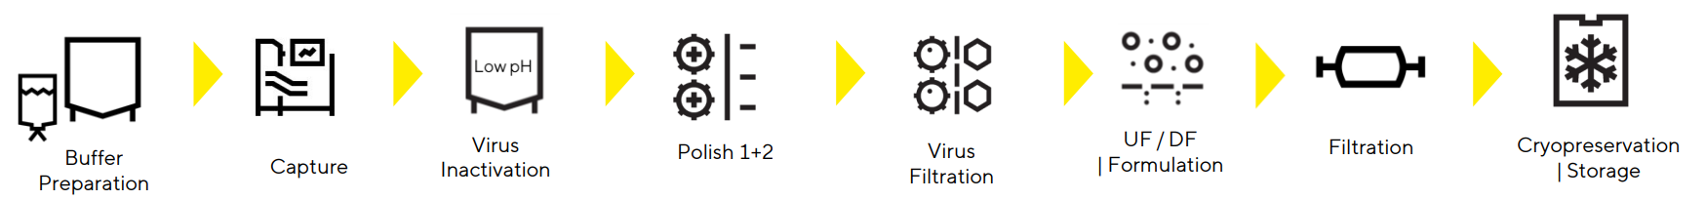
Mixing Is Found at Various Stages of the Drug Manufacturing Process
Introduction
Upstream
Mixing
Sterile
Filtration
Storage
Clarification
Mixing
Mixing
UF/DF
Storage
Media Preparation
Cell Culture
Cell Harvest | Removal | Clarification
Crossflow | Volume Reduction
Downstream
Mixing
Sterile
Filtration
Storage
Protein A Capture
Low pH virus inactivation
Polishing
Mixing
UF/DF
Storage
Buffer Preparation
Purification Steps
Form & Fill
Mixing
Sterile
Filtration
Storage
Mixing
Sterile
Filtration
Storage
Buffer Preparation
Final Formulation
Final Filling
Flexsafe® Pro Mixer 5 L | 10 L | 20 L

Slide 3




Challenges with Mixing at Low Volumes
Challenges
Drug degradation
Long mixing time to dissolve powders or highly viscous solutions
Shear stress is present in almost all bioprocesses and is known to play a role in degradation of various types of molecules (peptides, monoclonal antibodies, nucleic acid, viruses and viral vectors).
Achieving complete powder dissolution or homogeneity in highly viscous solutions often requires longer mixing times.
Validation effort when scaling from process development to clinical or commercial
Variability from batch to batch
Scaling up from low-volume mixing to larger production volumes necessitates extensive validation to ensure that the process remains consistent, and that the product quality is maintained. This can involve significant effort in terms of time and resources to confirm that the scaled-up process replicates the conditions of the low-volume mixing.
Using magnetic stir bars for low-volume mixing can lead to batch-to-batch variability due to inconsistent mixing patterns and shear rates. Variations in bar positioning, container geometry, and stirring speed can affect the distribution of components within each batch.

Slide 4
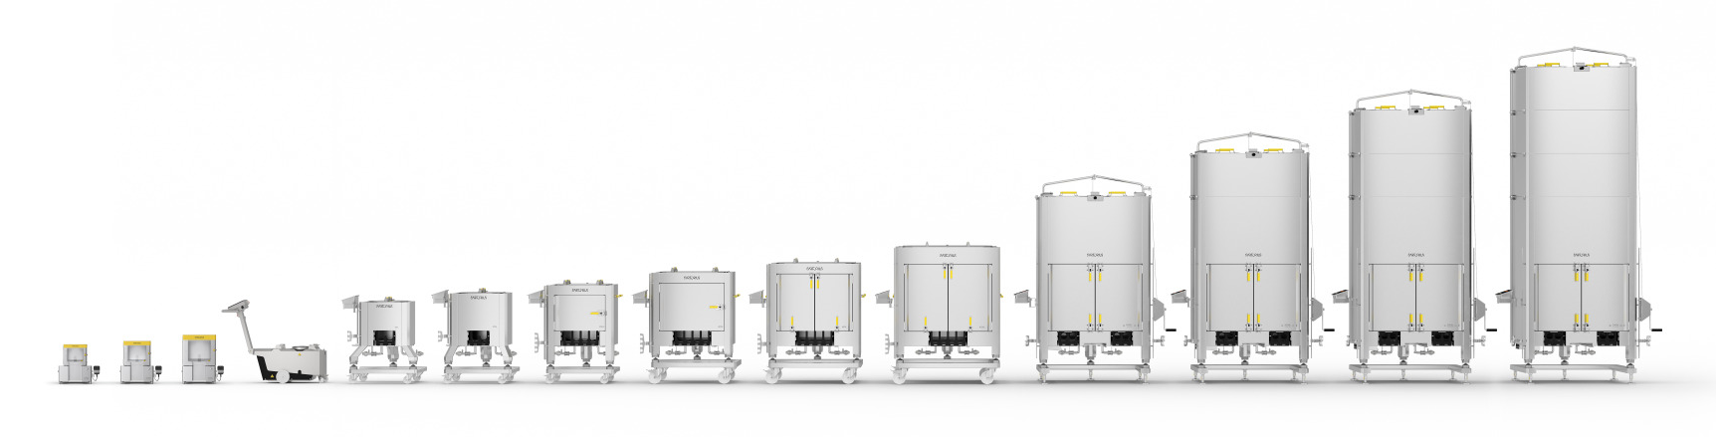
Flexsafe® Pro Mixer: One Single-Use Mixer for All Process Steps and Scales
Flexsafe® Pro Mixer
One Single Mixing Technology from 5 L to 3,000 L

Slide 5
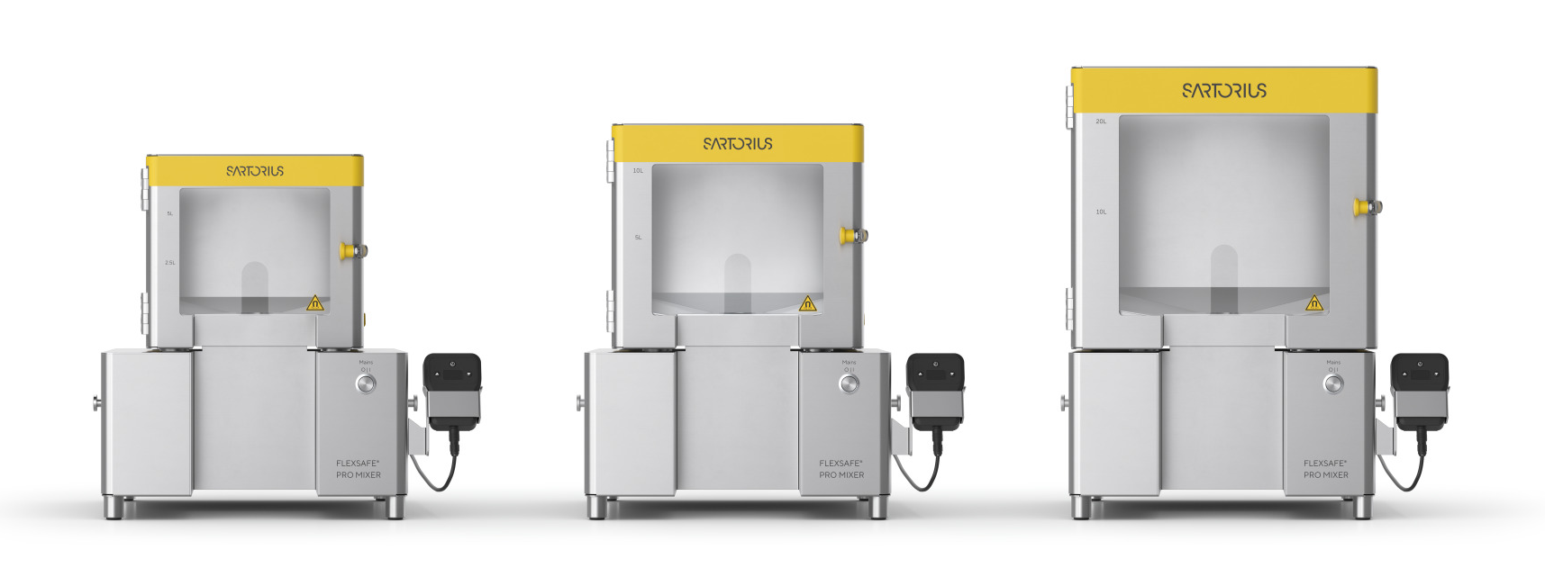
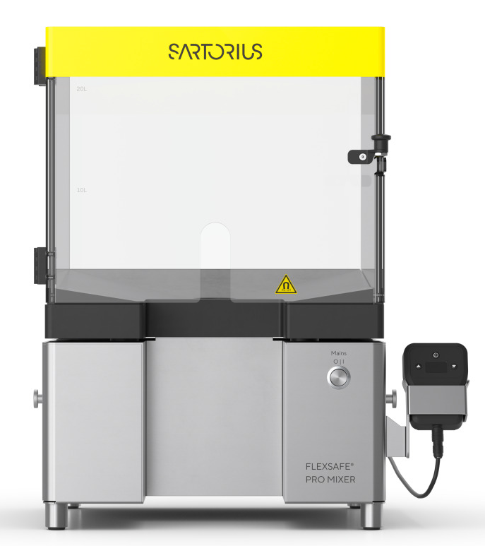
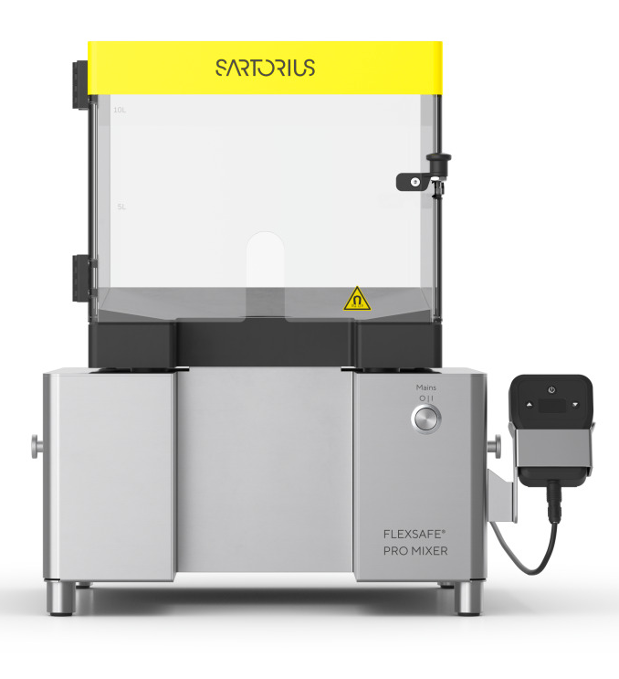
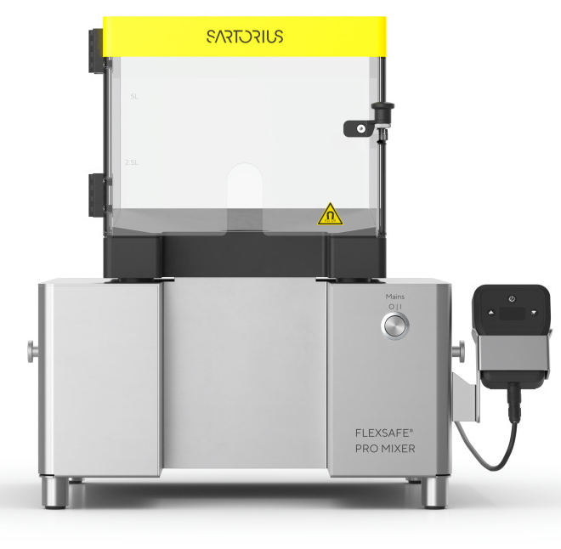
Flexsafe® Pro Mixer Hardware in Stainless-Steel or Plastic
Flexsafe® Pro Mixer
Flexsafe® Pro Mixer HW in Stainless-Steel
Flexsafe® Pro Mixer HW in Plastic

Slide 6
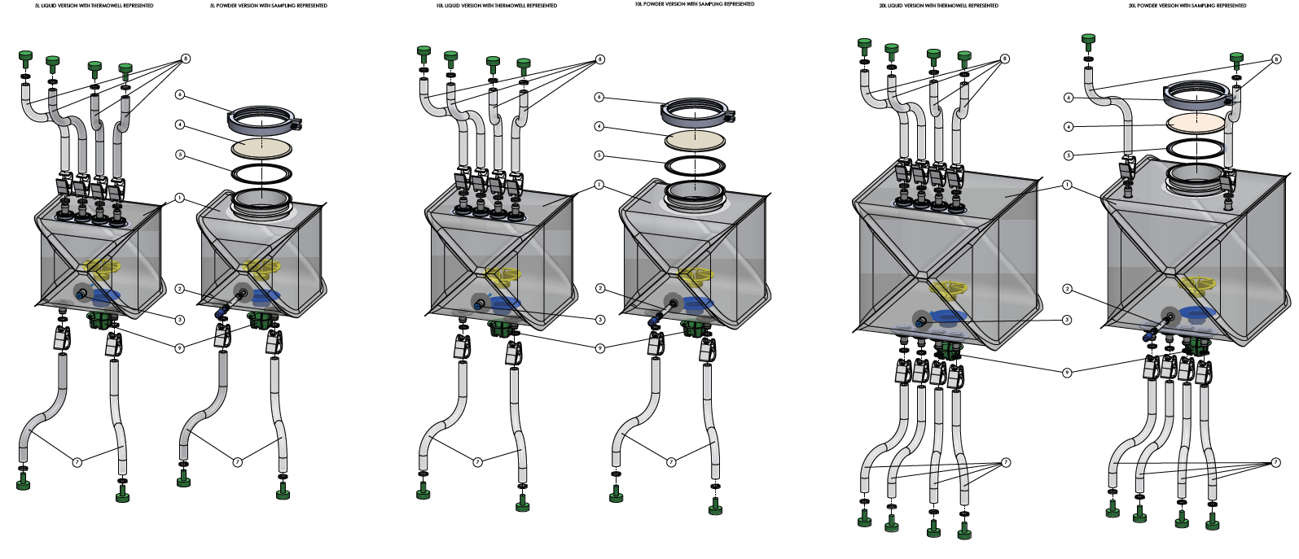
Flexsafe® Pro Mixer Single-Use Bags
Flexsafe® Pro Mixer

Slide 7
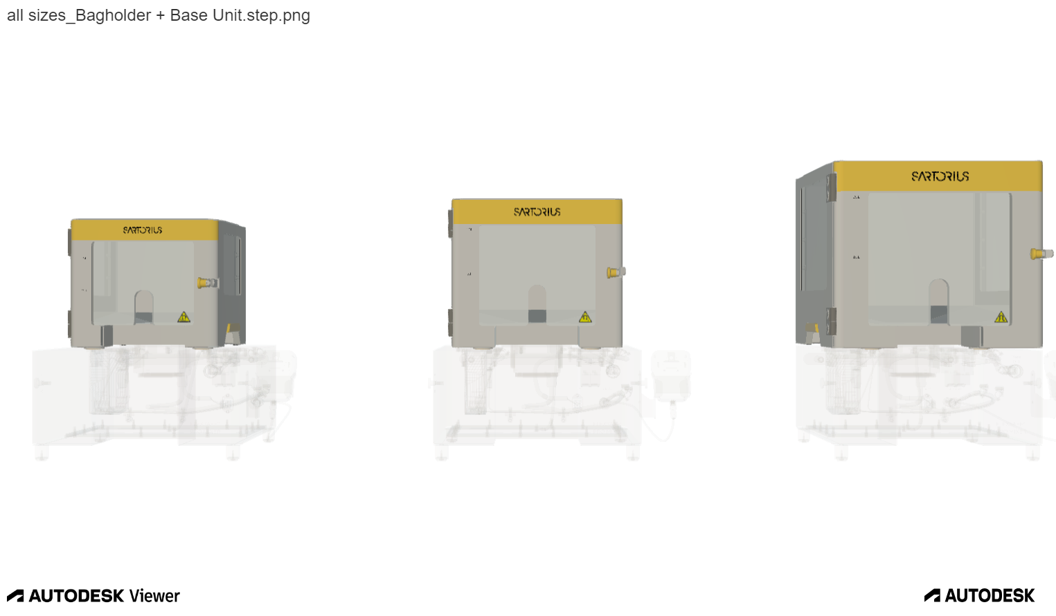
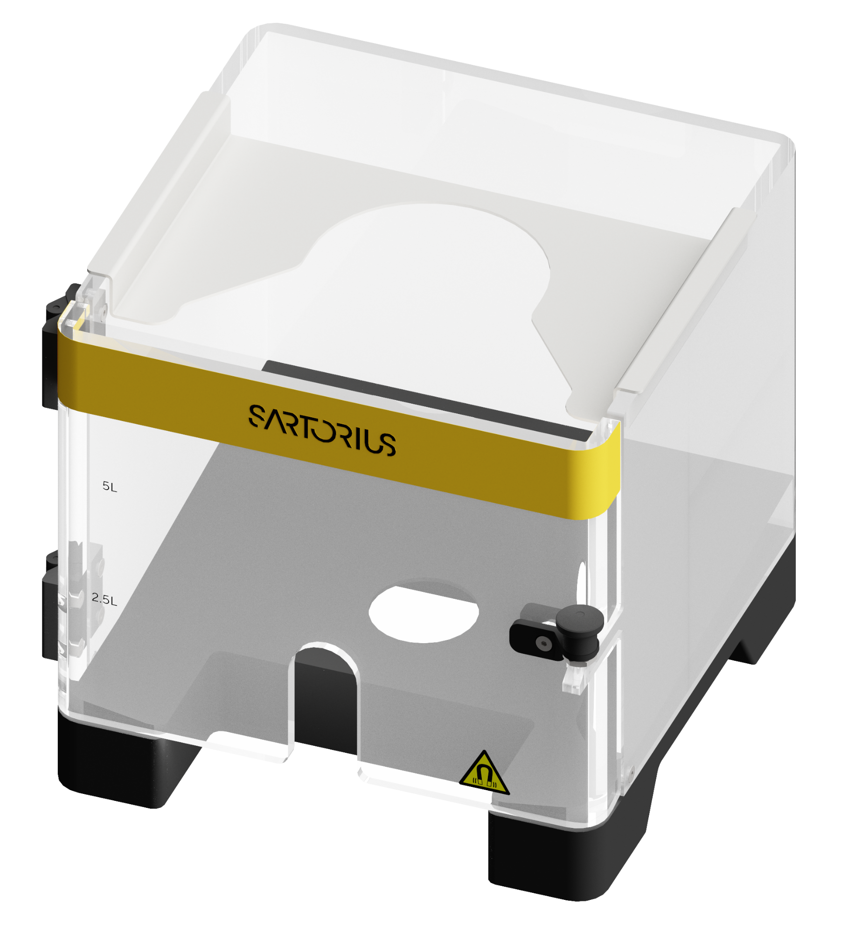
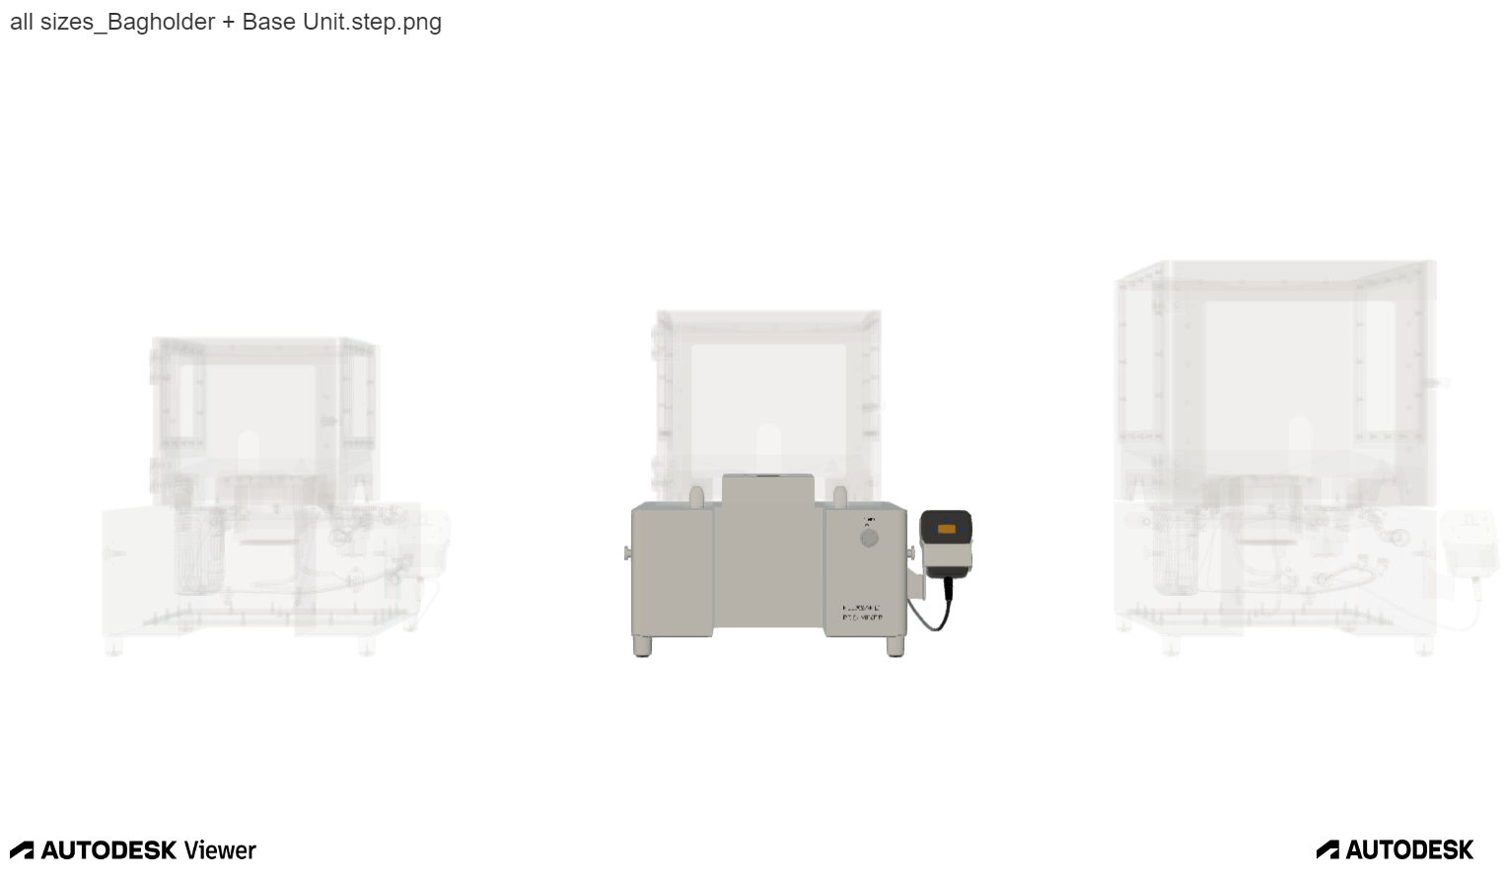
An Ease to Use, Flexible and Reliable Solution
Flexsafe® Pro Mixer
“Plug and mix” in less than 5 minutes
Impeller centered and stable by design
Monitor system parameters and control speed with remote connection for traceability purposes
1 single Flexsafe® Pro Mixer Base unit for the 3 sizes of Flexsafe® Pro Mixer Bag Holders 5 L, 10 L and 20 L, in stainless steel or in plastic
  Flexsafe® Pro Mixer Single-Use bags configurable for liquid-liquid or powder-liquid mixing
Openable 4” top port
Thermowell or Sampling Line
Silicon or TPE tubing for welding/sealing
Aseptic or non-aseptic connectors
Examples of Flexsafe® Pro Mixer 20 L bags

Slide 8
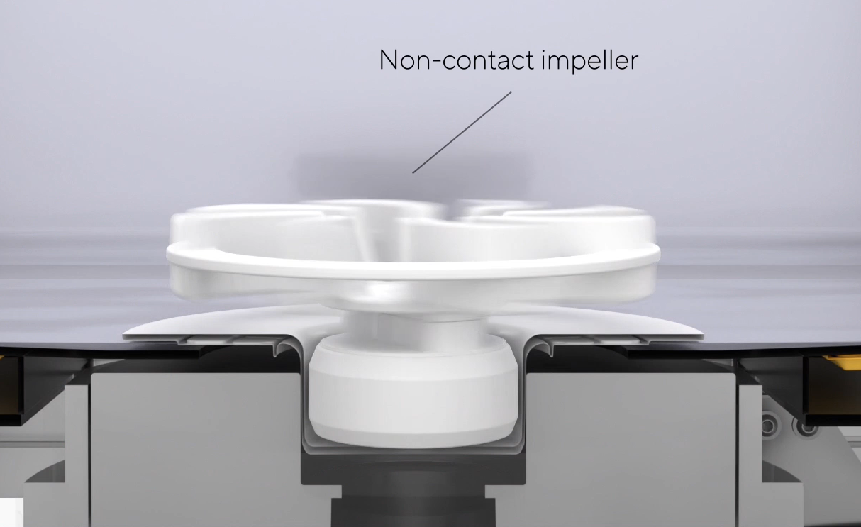
A Mixing Technology Combining Powerful and Low Shear Mixing
Flexsafe® Pro Mixer
Powerful mixing enabled by
  Electromagnets in motor drive permanent magnet inside bag
  High rotation speed of the single-use magnetic impeller up to 750 rpm
  High torque up to 10 N.cm
Low shear mixing is possible thanks to
  No moving parts within motor
  Contact free impeller limiting shear stress

Slide 9
Maximizing Buffers and Media Preparation with Efficient Mixing
Flexsafe® Pro Mixer
High torque and high speed allows fast powder dissolution in a few minutes

Slide 10
Ensuring Product Homogenization of Highly Viscous Solutions
Flexsafe® Pro Mixer
Viscosity of a mAb solution during final formulation is in the range of 1- 100 cP depending on the concentration^{1, 2, 3, 4, 5}
Homogenization time in less than 1 min at different impeller speeds and volumes
Capable of mixing very high-viscosity solutions - 37 minutes to homogenize solutions at 1200 cP
Product and Viscosity | Bag nominal volume [L] | Speed [rpm] | Mixing time 95% conductivity [s]
Water – 1 cP | 5 | 100 | < 1 min
Tris | 10 | 120 | 36
Tris | 20 | 150 | 36
PEG - 25 cP | 5 | 150 | 43
 | 10 | 170 | 53
 | 20 | 200 | 40
PEG – 75 cP | 5 | 300 | 34
 | 10 | 350 | 25
 | 20 | 450 | 43
Wang, W. (2005). Protein aggregation and its inhibition in biopharmaceutics. International Journal of Pharmaceutics, 289(1-2), 1-30.
Hamrang, Z. et al. (2014). Quantifying the effects of buffer additives on protein aggregation kinetics using light scattering. Biophysical Journal, 106(2), 374-383.
Loo, L. T., & Wong, R. L. (2017). Formulation of monoclonal antibody therapeutics: Influence of pH and buffers. Journal of Pharmaceutical Sciences, 106(6), 1536-1545.
Morishima, Y. et al. (2012). Viscosity of monoclonal antibody solutions as a function of concentration: Effect of buffer species and excipients. Journal of Pharmaceutical Sciences, 101(1), 204-213.
Shire, S. J. et al. (2004). Challenges in the development of high protein concentration formulations. Journal of Pharmaceutical Sciences, 93(6), 1390-1402.

Slide 11
Simplifying Process Scaling from Early Drug Development Stages
Flexsafe® Pro Mixer
  Use the same mixing technology, the same Flexsafe® film and the same material for all sizes up to 3,000 L from process development to commercial
  Predict mixing performances from small to large sizes up to 1,000 L with scalability model
    Prediction of the mixing time
    Estimation of the required speed that produce a similar mixing for different fluid volumes
    Estimation of mixing of a different volume while maintaining the same shear rate
  Extractables & Leachable Analyses with Confidence® when scaling down from larger to smaller volumes
Direct scaling between the mixing time and the relative input power P/V between 5, 10 and 20 L bags

Slide 12
Satisfying Your Process Requirements with Configurable SU Bags
Flexsafe® Pro Mixer
 | Component localization | Flexsafe® Pro Mixer bag 5 L and 10 L | Flexsafe® Pro Mixer bag 20 L
 | Top | No component OR Openable 4" top port OR Up to 4 lines if no top port Silicon (1/4" x 7/16") Up to 300 mm Aseptic and non-aseptic connectors | No component OR Up to 4 lines if no top port, Up to 2 lines if 4" top port Silicon (1/4" x 7/16") Up to 300 mm Aseptic and non-aseptic connectors
 | Front | No component OR Thermowell OR Sampling line | No component OR Thermowell OR Sampling line
 | Bottom | Up to 2 lines Silicon (3/8" x 5/8"; 1/4" x 7/16") OR TPE (3/8" x 5/8"; 1/4" x 7/16"; 1/4" x 3/8") Up to 1500 mm Aseptic and non-aseptic connectors | Up to 4 lines Silicon (3/8" x 5/8"; 1/4" x 7/16") TPE (3/8" x 5/8"; 1/4" x 7/16"; 1/4" x 3/8") Up to 1500 mm Aseptic and non-aseptic connectors
Flexsafe® Pro Mixer 5 L | 10 L | 20 L

Slide 13
Working Mixing Volume
Flexsafe® Pro Mixer
Bag Volume | Test case | Minimum working volume | Bag adjustment volume | Minimum Volume for temperature sensing | Max fill volume | Volume to Stop Sampling | Min volume to stop mixing | Residual volume by pump draining | Residual volume by gravity draining
 |  | (L) | (L) | (L) | (L) | (L) | (L) | (ml) | (ml)
5L | With pre-inflation / top port open | 0,5 | 3 | 2,7 | 5,5 | 1,4 | 0,5 | 71 | 69
5L | Without pre-inflation / top port closed | 0,6 | 3 | 3,5 | 5,5 | 0,85 | 0,7 | 32 | 91
10L | With pre-inflation / top port open | 0,6 | 6 | 3,1 | 11,0 | 2,1 | 0,7 | 93 | 94
10L | Without pre-inflation / top port closed | 0,7 | 6 | 6,2 | 11,0 | 1,3 | 1,2 | 64 | 94
20L | With pre-inflation / top port open | 0,7 | 12 | 5,6 | 22,0 | 4,5 | 0,8 | 88 | 105
20L | Without pre-inflation / top port closed | 1,6 | 12 | 11,1 | 22,0 | 3,8 | 3,3 | 74 | 135
This information is given for information purposes only, to characterize the operating volumes. The operating volumes in the table are average volumes from several trials. Those may vary according to bag deployment in the bag holder, bag dimensions and tolerances, bag configurations. filling, sampling, draining conditions. These data do not constitute a validation.

Slide 14
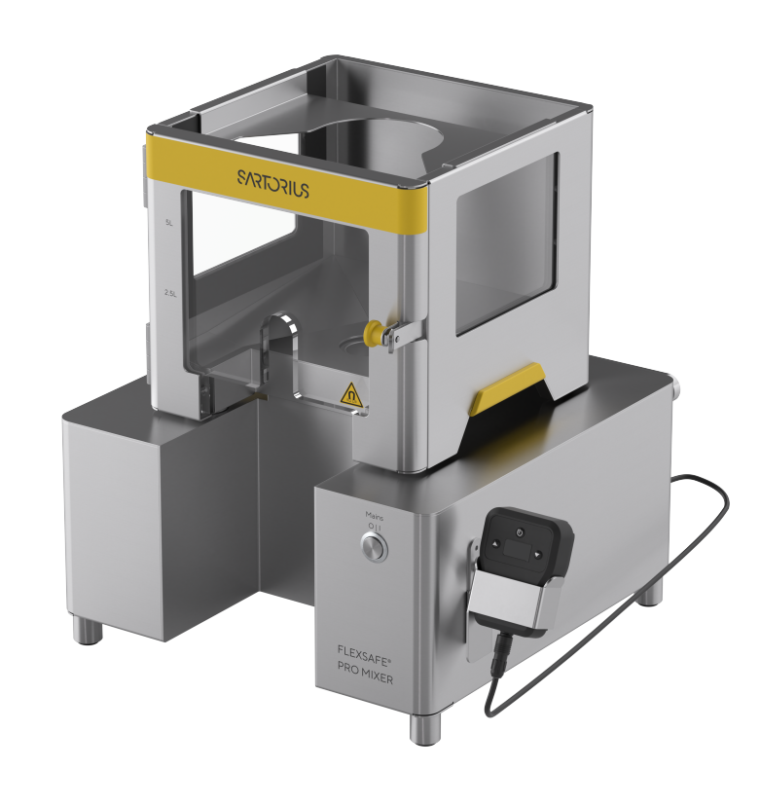
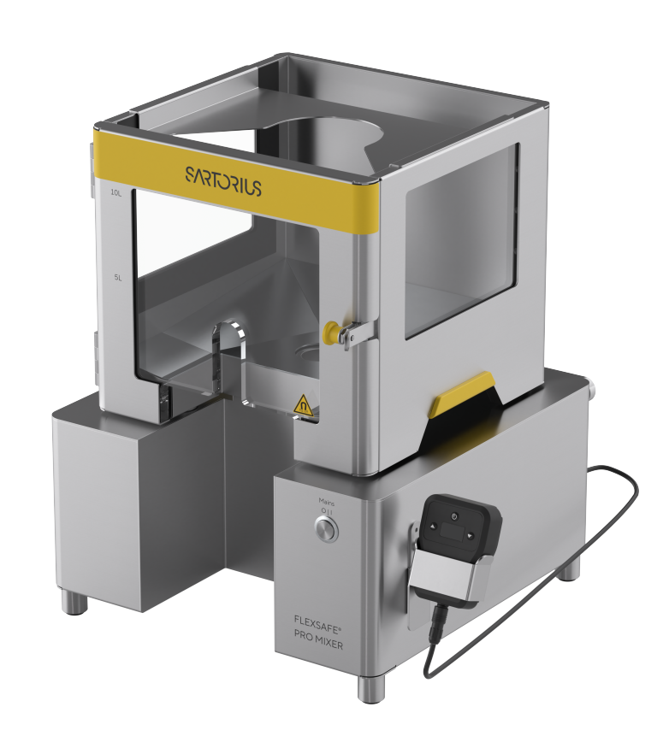
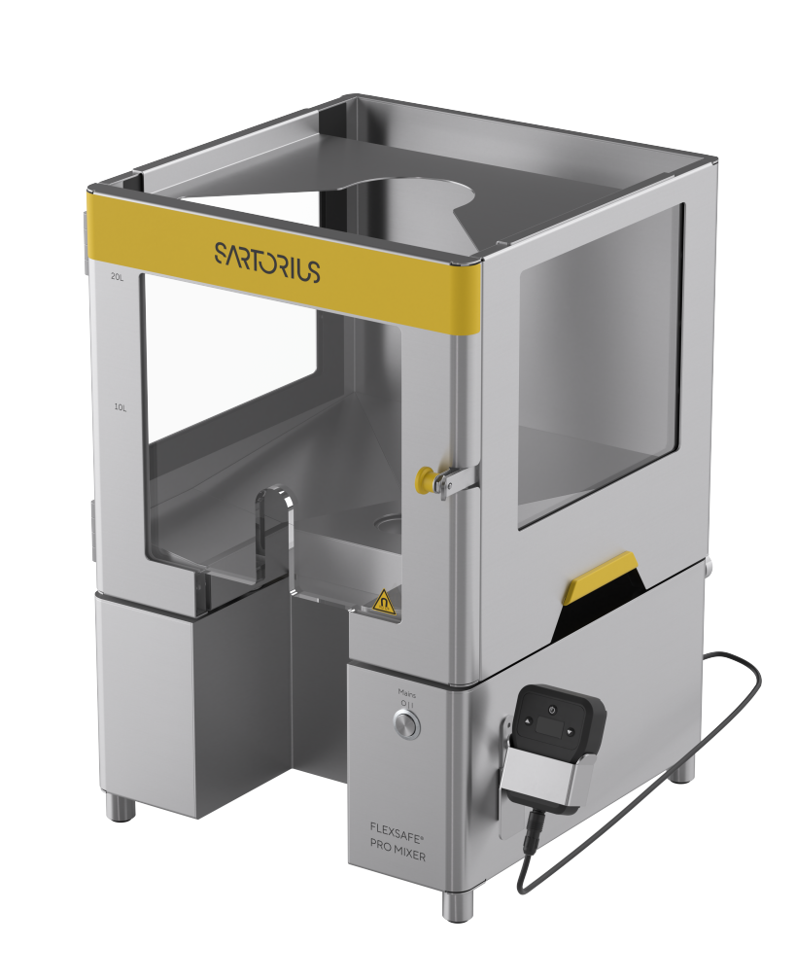
Flexsafe® Pro Mixer for 5L, 10L, 20L with stainless steel Bag Holders
Flexsafe® Pro Mixer
System | 5L | 10L | 20L
Total net weight (kg) | 11,5 + 6,5 = 18 | 11,5 + 8,6 = 20,1 | 11,5 + 12,6 = 24,1
Dimensions (W x D x H) | 468 x 452 x 439 | 468 x 452 x 475 | 468 x 452 x 540
Impeller speed (rpm) | 10 – 750 | 10 – 750 | 10 – 750
Temperature range (°C) | 2 - 30 | 2 - 30 | 2 - 30
Flexsafe® Pro Mixer 5 L | 10 L | 20 L

Slide 15
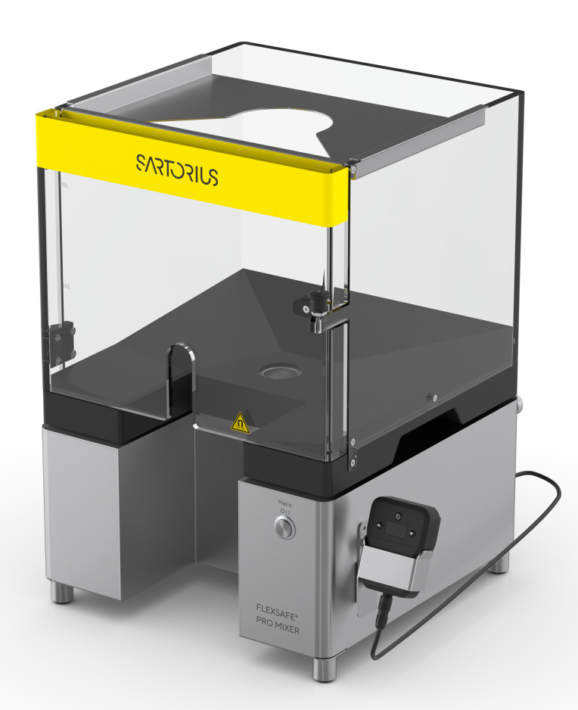
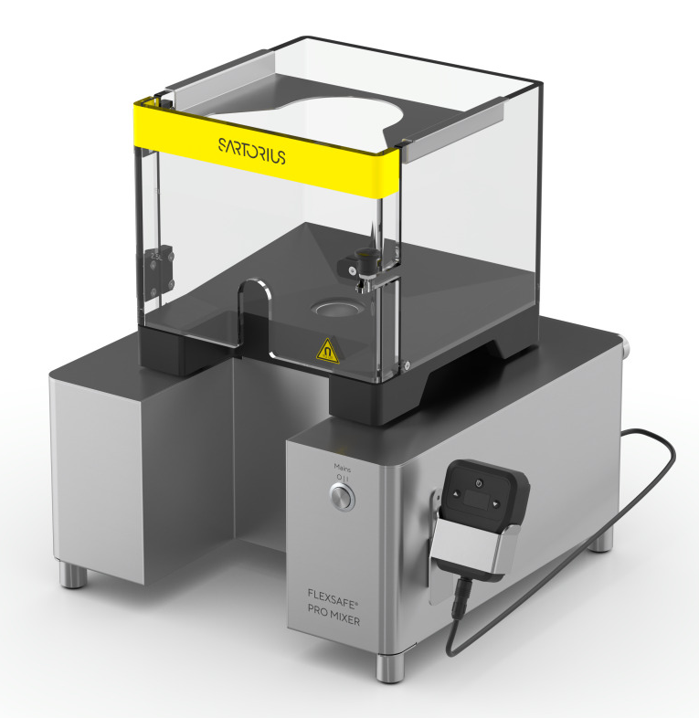
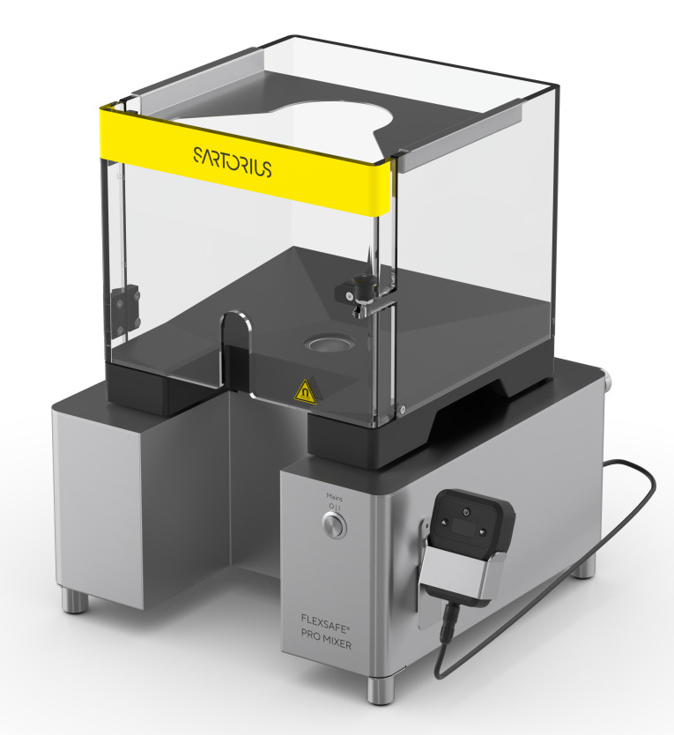
Flexsafe® Pro Mixer for 5L, 10L, 20L with plastic Bag Holders
Flexsafe® Pro Mixer
System | 5L | 10L | 20L
Total net weight (kg) | 11,5 + 2,9 = 14,4 | 11,5 + 4,4 = 15,9 | 11,5 + 8,7 = 20,2
Dimensions (W x D x H) | 468 x 452 x 437 | 468 x 452 x 473 | 468 x 452 x 533
Impeller speed (rpm) | 10 – 750 | 10 – 750 | 10 – 750
Temperature range (°C) | 2 - 30 | 2 - 30 | 2 - 30
Flexsafe® Pro Mixer 5 L | 10 L | 20 L

Slide 16
Cleaning Agents for the Bag Holders
Cleaning Agents | Compatibility
70% ethanol | 30% WFI | STS & Plastic
70% isopropanol | 30% WFI | STS & Plastic
1% hydrogen, 0.08% peracetic acid | STS & Plastic
6% H2O2 | STS & Plastic
Alcohol (isopropanol, ethanol, methanol, in concentrations of 60–70%), citric acid 10%, diluted H2O2 (3.5%), water | STS & Plastic
Vaporized hydrogen peroxide (dry procedure) | Only STS
16
Flexsafe® Pro Mixer 5 L | 10 L | 20 L
Notes:
Remark: Risk types: scope, schedule, market, resource, supplier, technology. Risk rates: 1-500.
Submitted -> new Risk for recent Red Flag Gate or still valid Risk from former Red Flag Gates
Approved -> Risks from former Red Flag Gate linked to approved Options
Rejected -> Risks from former Red Flag Gate linked to rejected Options
For new Red Flag Gate please create new Risks or change Status of still existing Risks for new Red Flag Gate to submitted.

Slide 17
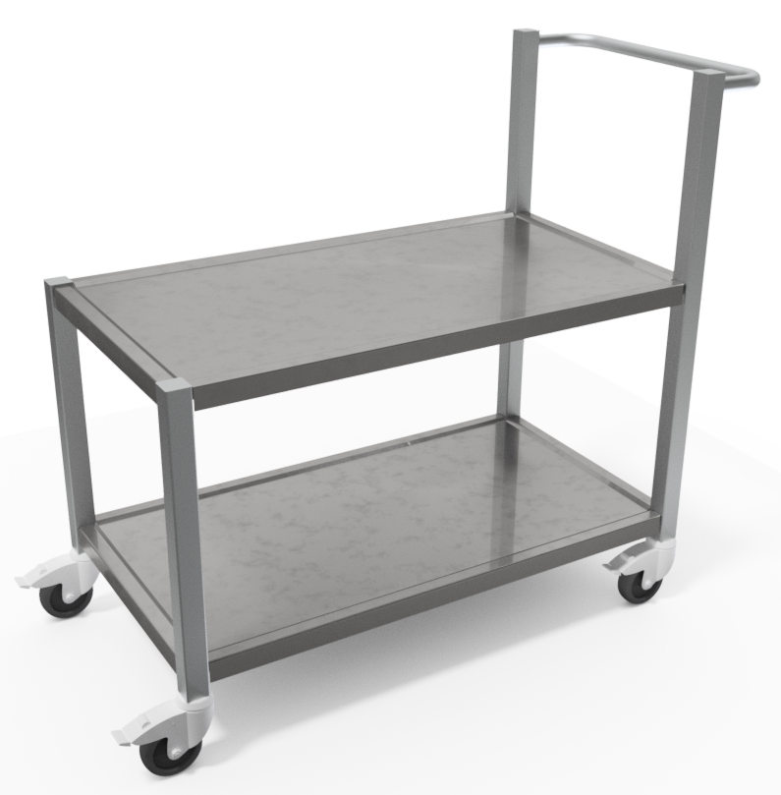
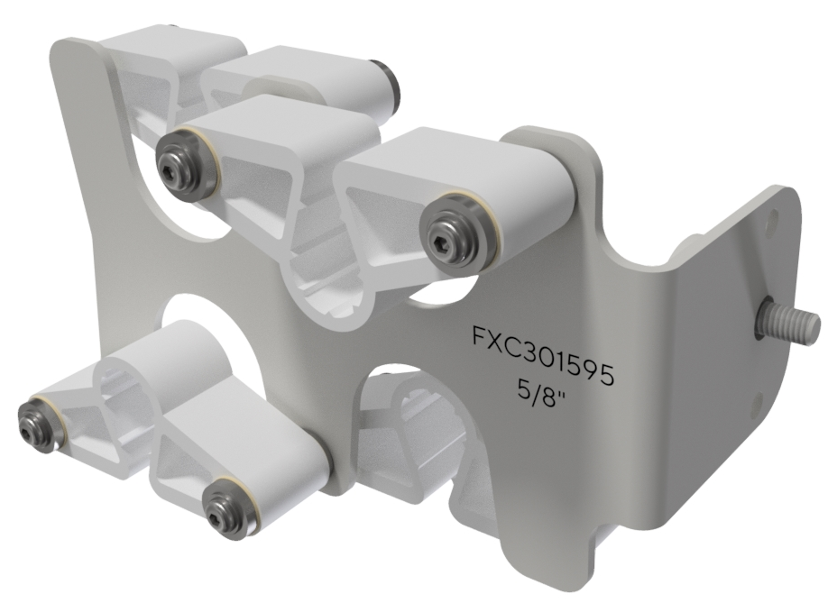
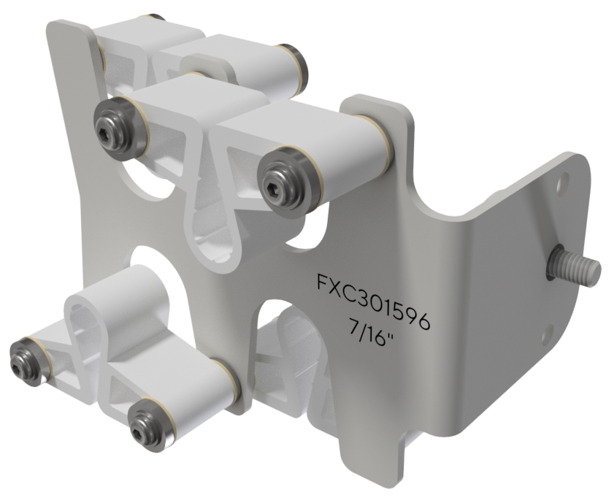
Flexsafe® Pro Mixer for 5 L, 10 L, 20 L Accessories
Flexsafe® Pro Mixer
Accessory | Tubing Holder 5/8” | Tubing Holder 7/16” | Lab Cart
Material Number | FXC301595 | FXC301596 | FXC301598
Total weight (kg) | 0,18 | 0,18 | 36
Dimensions (W x L x H) (mm) | 70 x 115 x 67 | 70 x 115 x 67 | 578 x 1 149 x 1 021
Flexsafe® Pro Mixer 5 L | 10 L | 20 L

Slide 18
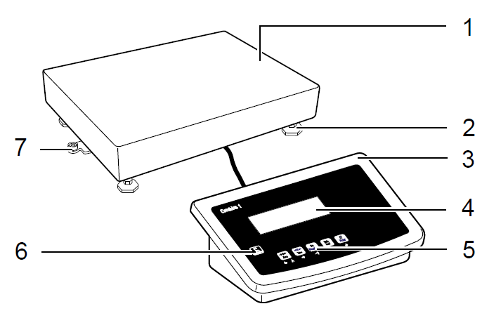
Flexsafe® Pro Mixer for 5 L, 10 L, 20 L Recommended Bench Scale
Flexsafe® Pro Mixer
Combics 1 Complete Scale Model CAW1S1-150FE-I
1 - Load plate
2 - Adjustable feet
3 - Analysis device
4 - Display Combics 1
5 - General function keys
6 - Switch on / off
7 - Level indicator
Flexsafe® Pro Mixer 5 L | 10 L | 20 L

Slide 19
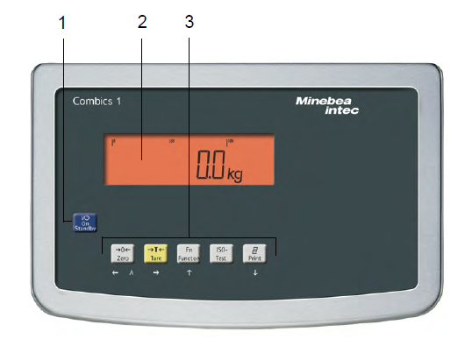
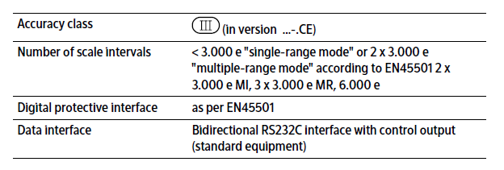
Flexsafe® Pro Mixer 5 L | 10 L | 20 L Recommended Bench Scale
Flexsafe® Pro Mixer
Combics 1 all stainless-steel
Model CAW1S1 (same as Palletank® Mixing)
Platform 150FE-I
500 x 400mm | Capacity 150kg
Resolution 5g
1 – Switch on / off
2 - Display
3 - General function keys
Flexsafe® Pro Mixer 5 L | 10 L | 20 L

Slide 20



Flexsafe® Pro Mixer
One Mixing Solution for All Mixing Steps and Scales
Flexsafe® Pro Mixer
Optimize Performance with Powerful & Low Shear Mixing
  Fast powder dissolution and homogenization of viscous solutions
  Prevent degradation of sensitive products
Optimize Time with Scalable Solution
  1 mixing technology up to 3,000 L
  Predict mixing performances when scaling up/down
Optimize Flexibility with 1 Mixer for All and Ease of Use
  1 motor for all sizes of bag holders
  Ergonomic handling
  Configurable SU bags
Flexsafe® Pro Mixer 5 L | 10 L | 20 L

Slide 21
Thank You

